Slide 1
Generation Z Learners’ Classroom Experiences in Surgical Technology Programs
Ashley Smith, PhD | Association of Surgical Technology National Educators Conference
Notes:
Welcome attendees and introduce yourself. Explain that this presentation is based on your dissertation research exploring how current instructional strategies align with Generation Z students’ learning preferences.

Slide 2



Do not edit
How to change the design
What word comes to mind when you think of Generation Z learners?
The Slido app must be installed on every computer you’re presenting from

Slide 3


Slide 4


Slide 5


Slide 6



Slide 7


Slide 8

Background & Problem Statement
• Gen Z = Digital natives, collaborative learners
• Limited studies in surgical technology education
• Need to align instruction with generational traits
Notes:
Discuss Gen Z’s defining traits—tech fluency, interactivity—and how traditional teaching models may not meet their needs (Shorey et al., 2021).

Slide 9

Do not edit
How to change the design
Which characteristic do you think is most defining for Generation Z learners?
The Slido app must be installed on every computer you’re presenting from

Slide 10
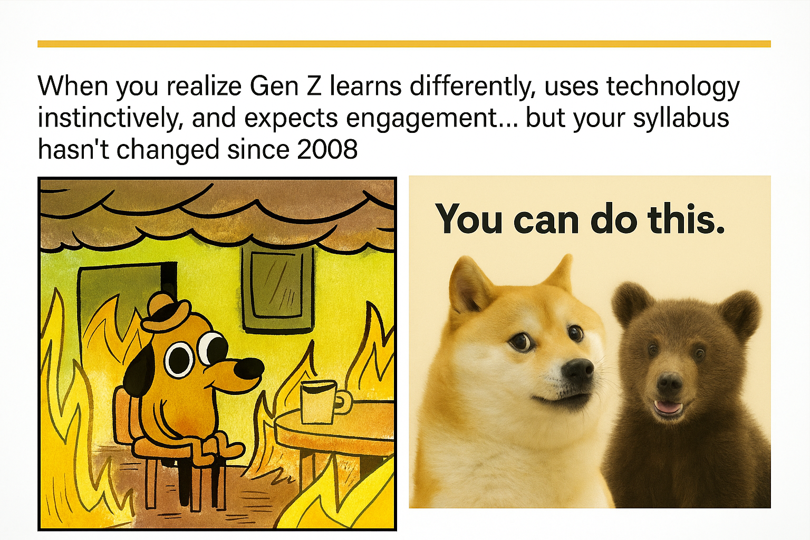
Session Overview
• Explore Gen Z learning preferences
• Review research design & findings
• Discuss practical applications
• Engage in Q&A
Notes:
Outline the goals for the next 50 minutes. Encourage audience reflection on their own classroom experiences.

Slide 11

Me rewriting my syllabus again to keep up with Gen Z

Slide 12
Theoretical Framework
• Knowles’ Andragogical Model: Self-directed, experiential learning
• Bandura’s Self-Efficacy Theory: Confidence & motivation
• Intersection: Empowered, tech-savvy learners
Notes:
Explain how adult learning and self-efficacy frameworks guide this study. Use visuals to illustrate overlaps between the two theories (Knowles, 1984; Bandura, 1977).

Slide 13
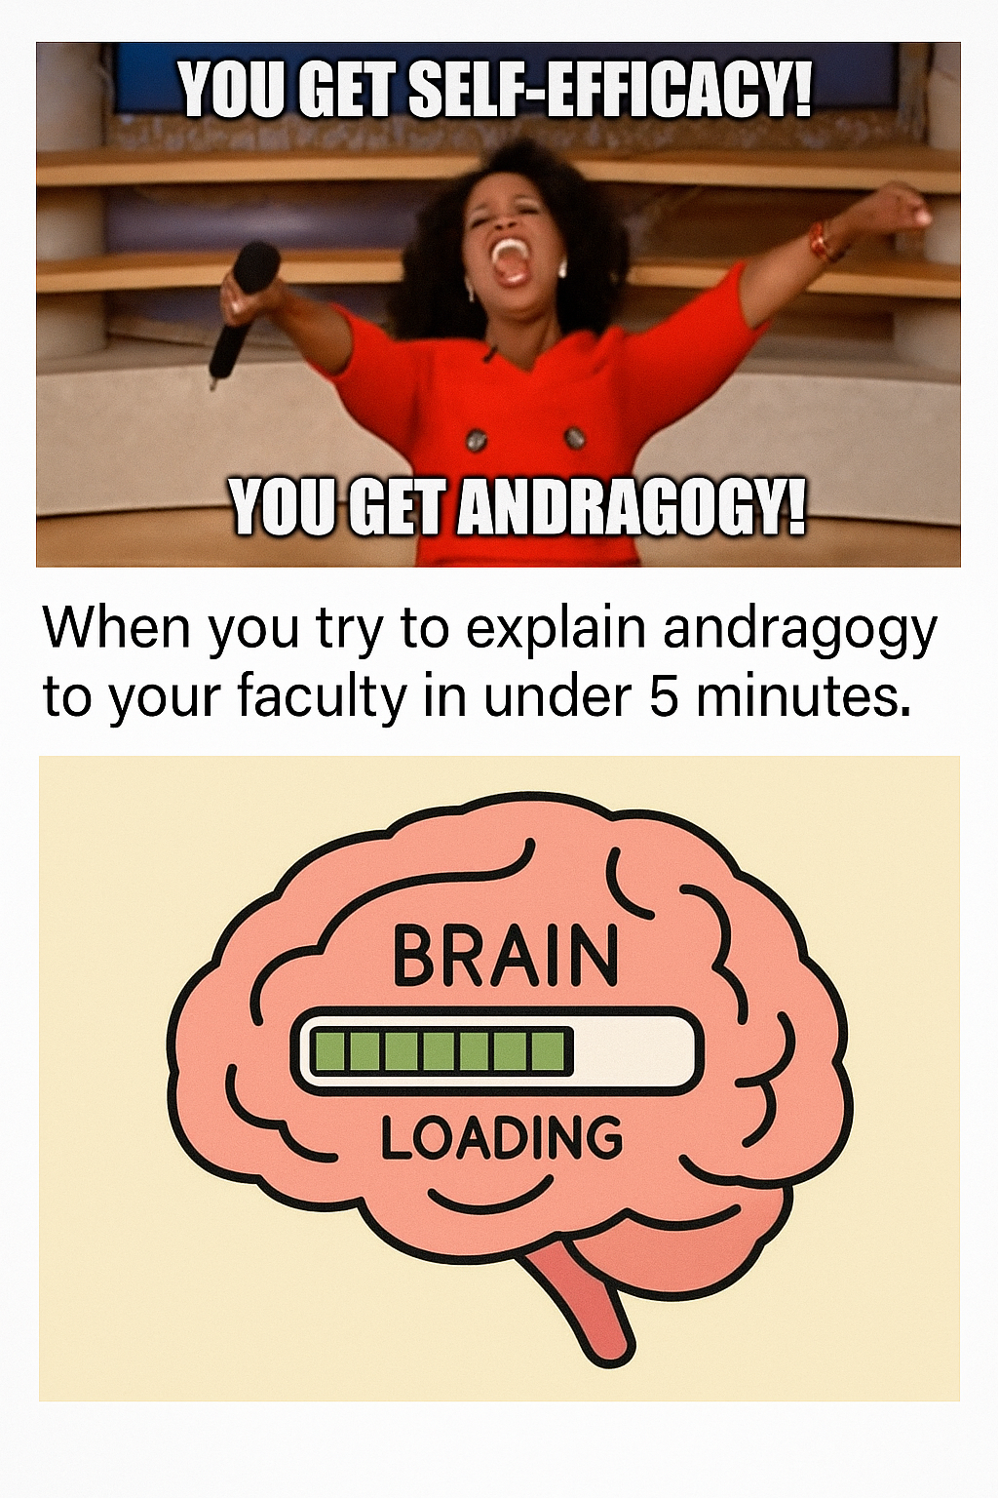

Slide 14

Literature Review Highlights
• Preference for hands-on, interactive learning (Seemiller & Grace, 2017)
• Need for immediate feedback (Hernandez-de-Menendez et al., 2020)
• Technology integration challenges
Notes:
Summarize major themes from literature about Gen Z learners in healthcare education and the ongoing gap in surgical technology-specific research.

Slide 15
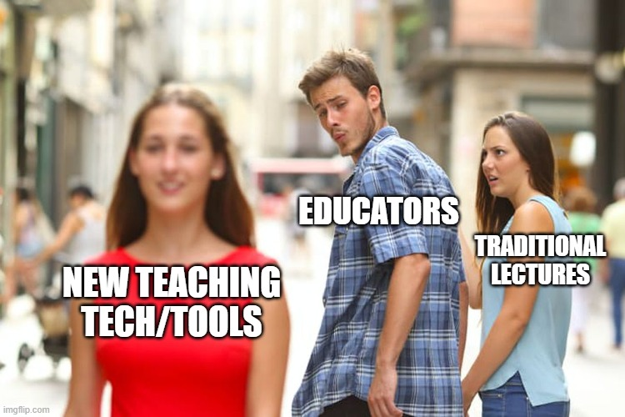

Slide 16


Slide 17
Methodology
• Generic qualitative design
• 9 participants, ages early 20s–30s
• Semi-structured interviews, thematic analysis
• Creswell & Poth’s Data Spiral process
Notes:
Highlight qualitative rigor—credibility, transferability, dependability. Emphasize purposive sampling for Gen Z surgical technology students.

Slide 18

Do not edit
How to change the design
How confident do you feel in adapting your teaching methods for Generation Z students?
The Slido app must be installed on every computer you’re presenting from

Slide 19


Slide 20

Major Findings
1. Kinesthetic & interactive learning preferred
2. Instructor engagement impacts motivation
3. Lecture-heavy instruction disengages
4. Limited but desired tech use
5. Strong student resilience
Notes:
Walk through each finding with supporting participant quotes. Link back to how each theme supports or challenges current instructional methods.

Slide 21


Slide 22
Implications for Educators
• Emphasize engagement and feedback
• Integrate simulation and VR tools
• Encourage collaboration & self-direction
• Redesign didactic models for Gen Z
Notes:
Offer practical strategies for surgical technology educators to improve student motivation, engagement, and learning outcomes (George et al., 2024).

Slide 23
Do not edit
How to change the design
What do you think is the biggest challenge in integrating technology in education?
The Slido app must be installed on every computer you’re presenting from

Slide 24


Slide 25


Slide 26
Recommendations & Future Research
• Faculty development for generational pedagogy
• Policy support for tech integration
• Multi-site and longitudinal research
• Explore cross-generational classrooms
Notes:
Highlight opportunities for national collaboration and curriculum innovation. Invite educators to consider how their institutions can adopt these strategies.

Slide 27

Do not edit
How to change the design
Rank these strategies for improving engagement with Generation Z learners.
The Slido app must be installed on every computer you’re presenting from

Slide 28


Slide 29


Slide 30
Conclusion & Q&A
Key Takeaways:
• Align instruction with Gen Z traits
• Foster confidence through feedback
• Blend technology and collaboration
Questions?
Notes:
Summarize study relevance: Gen Z learners are resilient, tech-savvy, and prefer interactive instruction. Thank the audience and open for Q&A.

Slide 31

Do not edit
How to change the design
What is one change you plan to implement in your teaching for Gen Z learners?
The Slido app must be installed on every computer you’re presenting from

Slide 32
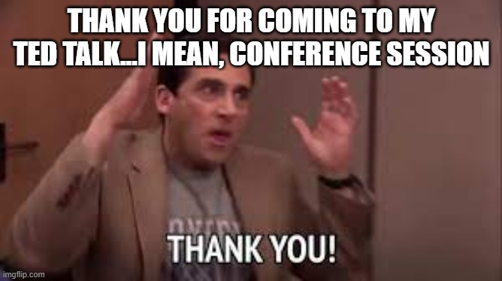

Slide 33
