Slide 1

Teaching Smarter,
How AI-Powered Handouts are Revolutionizing Surgical Tech Classrooms
John Ratliff, MHA, CST, FAST
2026 AST Educators Conference | February 6–7, 2026 | Nashville, TN
Notes:
OPEN (0:00–1:00)
• I’m going to show you the exact handout workflow I use every week and the prompts that keep it consistent.
• AI drafts fast. I decide what’s correct, what’s safe, and what goes to students.
• You don’t have to be technical to do this.
SET THE ROOM (1:00–3:00)
• 50 minutes total. I’m leaving time for questions and I want real educator questions.

Slide 2
What you’ll leave with
Beginner friendly. Copy, paste, and use this tomorrow.
A 6-step workflow you can repeat every week
A starter prompt set that produces predictable output
How to keep it in your voice and keep it clean in Canvas
A 60 second quality check for safety, scope, policy, and IFU
Time for Q&A built in
Teaching Smarter • AST Educators 2026
Notes:
PROMISE (3:00 to 6:00)
• In this session you will leave with the workflow and the prompts.
• I will show real examples, then we will walk the sequence.
• There is a copy and paste slide for a General Surgery procedure handout using Fuller 8e.
• I am protecting question time, so stop me if something is unclear.

Slide 3
The why
Why these handouts change what students do in class
Students stop drowning in text and start thinking in steps
Consistency reduces confusion: same format and expectations every week
Handouts become a pre-lecture or procedure scan or what to expect.
You gain time to teach, and students have your lecture in a handout format, write less and listen more.
Teaching Smarter • AST Educators 2026
Notes:
WHY (6:00 to 10:00)
• Some of you are skeptical about AI. That is healthy. I was too.
• What changed my mind was not fancy tech. It was the handouts getting better and faster.
• Students do not need more pages. They need clear steps and the same structure every week.
• When the format is consistent, students stop guessing what matters and start thinking like a surgical technologist.
• AI drafts the first version. The educator controls accuracy, safety, scope, and standards.

Slide 4
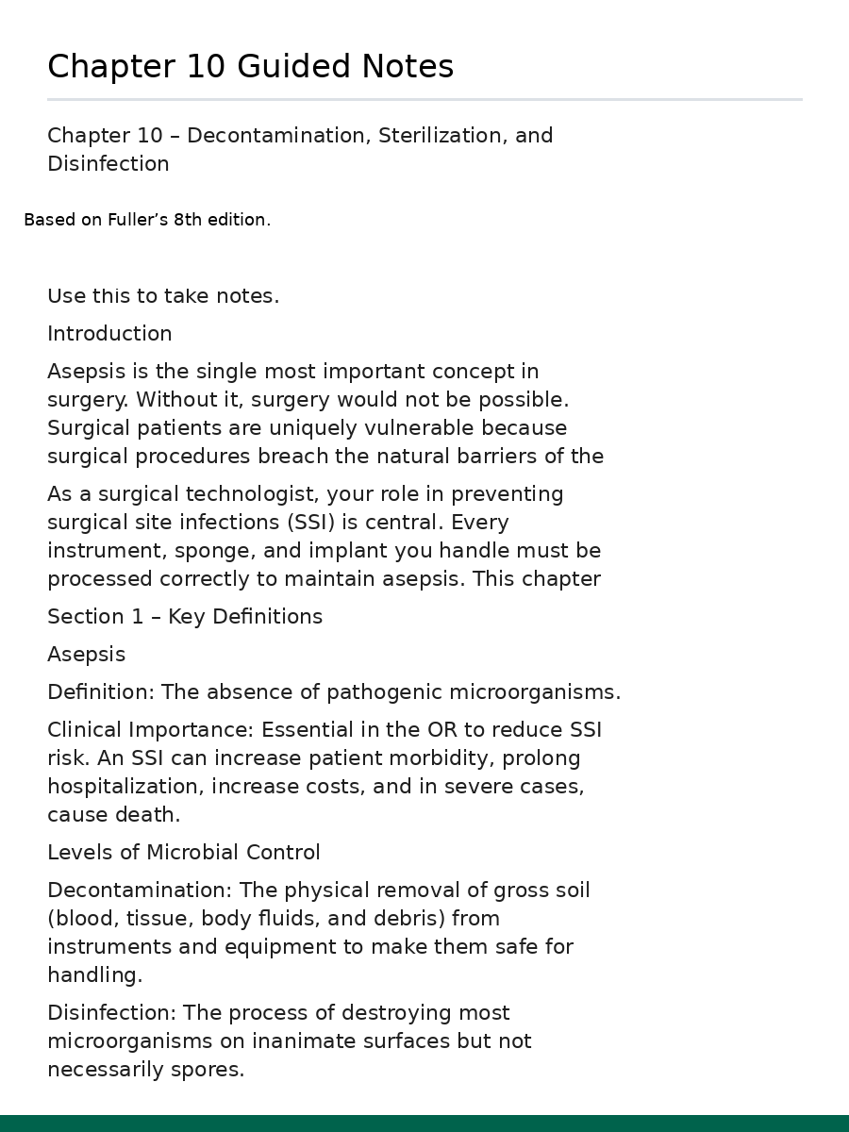
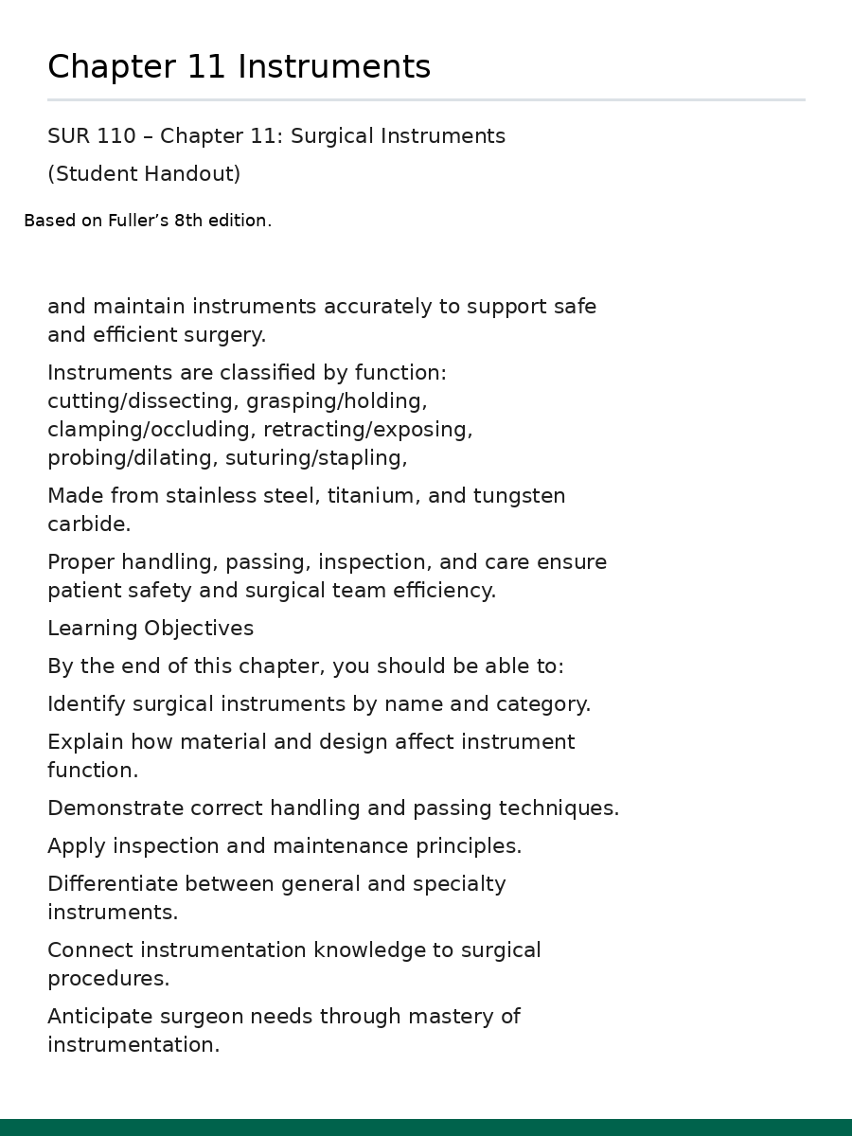
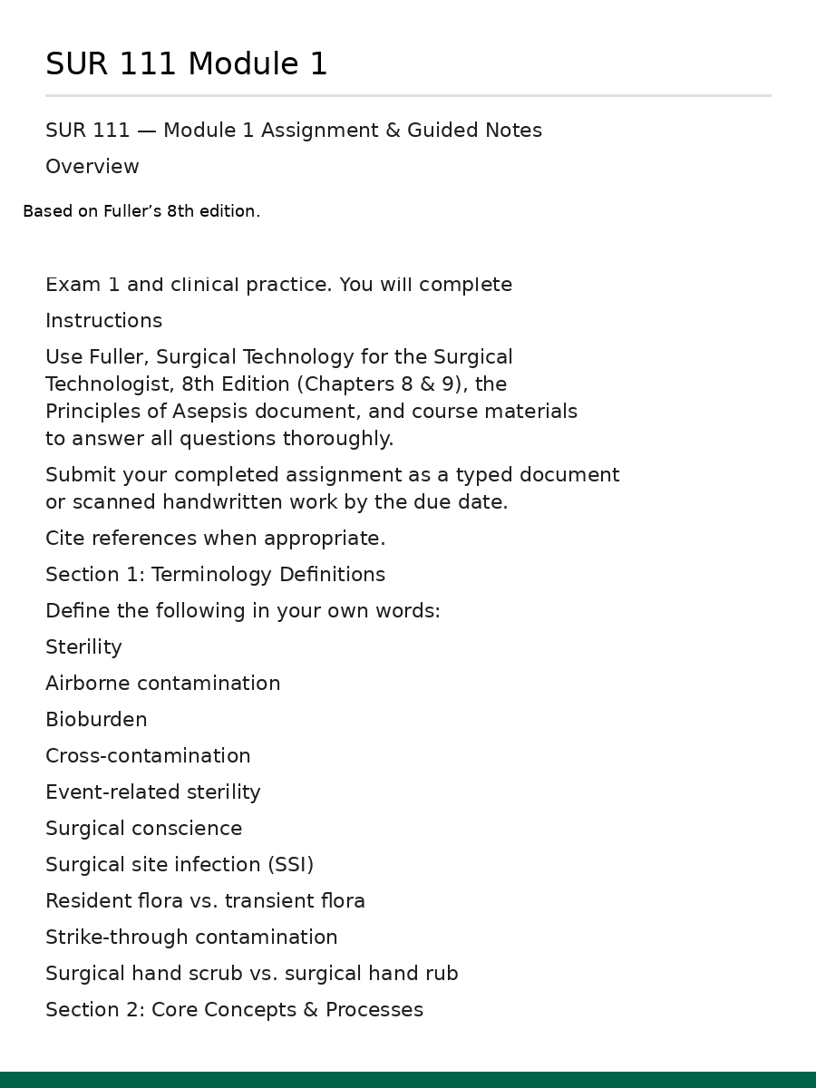
Real handout examples
These are from my courses
Teaching Smarter • AST Educators 2026
Notes:
REAL EXAMPLES (10:00–13:00)
• These are real files from my courses.
• The secret is the pattern: students learn the structure and stop guessing what matters.
• Built from my notes + assigned readings, then tightened to one usable page.

Slide 5
The workflow
The exact sequence we use to build handouts
1 Give context
2 Lock the format
3 Draft fast
4 Tighten to your voice
5 Quality check
6 Finalize + publish
Loop point: steps 4 and 5 repeat until it reads clean and stays safe.
Teaching Smarter • AST Educators 2026
Notes:
THE WORKFLOW (13:00–18:00)
Walk the 6 steps:
1 Give context
2 Lock the format
3 Draft fast
4 Tighten to your voice
5 Quality check
6 Finalize + publish
Key line:
• Steps 4 and 5 loop until it reads clean and stays safe.
• Format lock first so output is predictable.

Slide 6
Prompt 1: Context + format lock
Copy, paste, replace the topic
You are helping me create a student guided notes handout for surgical technology.
Course: SUR 111 (first semester) or SUR 122AB (second semester).
Topic: [paste your chapter or procedure here].
Format lock:
Use headings in this order: Overview, Objectives, Key terms, Core concepts, Critical thinking prompts, Quick check.
Use lists and short paragraphs. No dense blocks.
Headings can be bold. Body text should not be bold.
No dashes. Use white space.
Quality lock:
Stay within the role of the surgical technologist.
Include facility policy and manufacturer IFU language where it controls the decision.
Output: paste-ready handout.
Source anchor:
Use Fuller’s 8th edition (assigned reading) and my pasted notes.
Do not add steps, instruments, or facts that are not in my source.
If you are unsure, ask me what to use.
Teaching Smarter • AST Educators 2026
Notes:
PROMPT 1 (18:00–22:00)
Explain:
• You’re not asking AI to be smart. You’re forcing structure.
Point out:
• Course level + topic + headings + formatting rules.
• Body text stays plain. Avoid dense blocks.
• Quality lock: scope, policy, IFU.

Slide 7
Prompt 2: Make it sound like you
This removes the AI sound
Rewrite this to match my teaching voice.
Keep it direct and instructional.
Remove filler and generic motivational language.
Increase white space and readability.
Use the term surgical technologist.
No dashes.
Return the cleaned handout.
Teaching Smarter • AST Educators 2026
Notes:
PROMPT 2 (22:00–25:00)
• This is where generic output becomes your voice.
• Direct, instructional, remove filler, add white space.
• Use “surgical technologist.” No dashes.

Slide 8
Prompt 3: Cut to high yield
This is where the handout becomes usable
Cut this down to what a student needs for tomorrow.
Keep only must-know content for the course level.
Move anything nice-to-know into a small box or remove it.
Return a one-page guided notes handout that supports lecture today and becomes a quick review sheet for quizzes and exams.
Teaching Smarter • AST Educators 2026
Notes:
PROMPT 3 (25:00–28:00)
• Most people keep too much. Students won’t read it.
• Must-know for tomorrow. Nice-to-know goes to a small box or gets removed.
• Goal: one page that is easy to follow.

Slide 9
The 60 second quality check
Guardrails for safety and accuracy
Accuracy: steps and terminology match your source and course level
Safety: sharps, counts, specimen, positioning risks are correct
Scope: it does not imply restricted actions for the surgical technologist
Policy and IFU: it points back to facility policy and manufacturer instructions
Readability: students can scan it before a case
Teaching Smarter • AST Educators 2026
Notes:
QUALITY CHECK (28:00–34:00)
This is the safety net:
• Accuracy
• Safety
• Scope
• Policy/IFU
• Readability
Key phrase:
• If it implies the wrong role, it’s unsafe even if the facts are correct.

Slide 10
Live demo (beginner version)
What to do on screen in under 5 minutes
Paste your topic and course level
Run Prompt 1 to generate the draft
Run Prompt 2 to match your voice
Run Prompt 3 to cut it to one page
Run the 60 second quality check before posting
Prompt 1 is slide 6 (context + format lock). Prompt 2 is slide 7 (match your voice). Prompt 3 is slide 8 (cut to high yield).
Teaching Smarter • AST Educators 2026
Notes:
LIVE DEMO (beginner version)
Before you start, tell them where the prompts live:
• Prompt 1 is slide 6 (context + format lock)
• Prompt 2 is slide 7 (match your voice)
• Prompt 3 is slide 8 (cut to high yield)
Then do the five moves:
1 Paste your topic and course level
2 Run Prompt 1
3 Run Prompt 2
4 Run Prompt 3
5 Run the 60 second quality check before posting

Slide 11
Make it look professional in Canvas
Simple rules that keep it clean
Use one font and consistent sizes (Calibri works)
Avoid crowded boxes and tiny text
Use headings in the same order every week
Test inside Canvas before you publish
Teaching Smarter • AST Educators 2026
Notes:
CANVAS / CLEAN LAYOUT (39:00–42:00)
• If it looks busy in Word, it will look worse in the LMS.
• One font, readable sizes, consistent headings, test in Canvas.
• Add alt text to any images.

Slide 12
Copyright & classroom use
Practical guardrails (not legal advice)
Use your own notes first. If you use publisher resources, stay inside your license and institution policy.
Keep excerpts small and purposeful. Do not recreate chapters or replace the textbook.
Cite your source materials (title, edition, chapter, figure).
Keep materials behind the LMS login. Do not post publisher content publicly.
When in doubt, link to the publisher resource instead of copying it.
References: 17 U.S.C. §107 (Fair Use) and §110 (Teaching exemptions). Check your institution policy/licensing.
Teaching Smarter • AST Educators 2026
Notes:
COPYRIGHT (42:00–45:00)
Tone: practical guidance, not legal advice.
• I build from my lecture notes and assigned readings.
• Content checks: Sources I use for content checks: Fuller’s 8th edition, Nemitz, and Howe & Burton (pharmacology).
• If you use publisher resources, stay inside your institution policy and your license.
• Keep excerpts small, cite, don’t replace the textbook, keep it behind the LMS login.
• When in doubt, link instead of copy.

Slide 13
Copy, paste: General Surgery procedure handout
You are helping me create a one page student handout for surgical technology.
Course level: SUR 122AB (second semester) or CST review.
Topic: [procedure name], general surgery.
Source: I will paste the key section from Fuller’s 8th edition. Use ONLY what I paste.
Format lock (use these headings in this order):
1. Overview (1 to 2 sentences)
2. Indications and anatomy focus (high yield)
3. Anesthesia and positioning
4. Prep and drape (what matters, what to watch for)
5. Key instruments and supplies (grouped, not a long random list)
6. Step by step case flow (major steps only)
7. Safety watch outs (counts, specimen, sharps, positioning, energy, drains)
8. Quick check (5 questions students should be able to answer)
Rules:
Lists and short paragraphs only. No dense blocks. Use white space.
Headings can be bold. Body text should not be bold.
Use the term surgical technologist.
No dashes.
Stay inside the surgical technologist scope.
Output: paste ready handout.
Teaching Smarter • AST Educators 2026
Notes:
USE THIS AS YOUR COPY AND PASTE SLIDE
• Tell them: if you are following along on your laptop, start here.
• Explain the key idea: you are forcing structure so the handout comes out clean.
• Emphasize: paste the Fuller excerpt. AI is not allowed to invent anything.
• Then run the voice cleanup prompt and the one page prompt.

Slide 14
Thanks
Questions? Show me what you built.
John Ratliff, MHA, CST, FAST
jdratliff2@gtcc.edu
Bring a topic and your course expectations. I’ll show you how to turn it into a clean, consistent handout.
Teaching Smarter • AST Educators 2026
Notes:
CLOSE + Q&A (45:00–50:00)
• Bring me a topic and your course expectations. I’ll show you how I turn it into a clean, consistent handout.
• Questions: what are you teaching next week, and what’s the pain point (time, consistency, layout, safety)?

